Slide 1
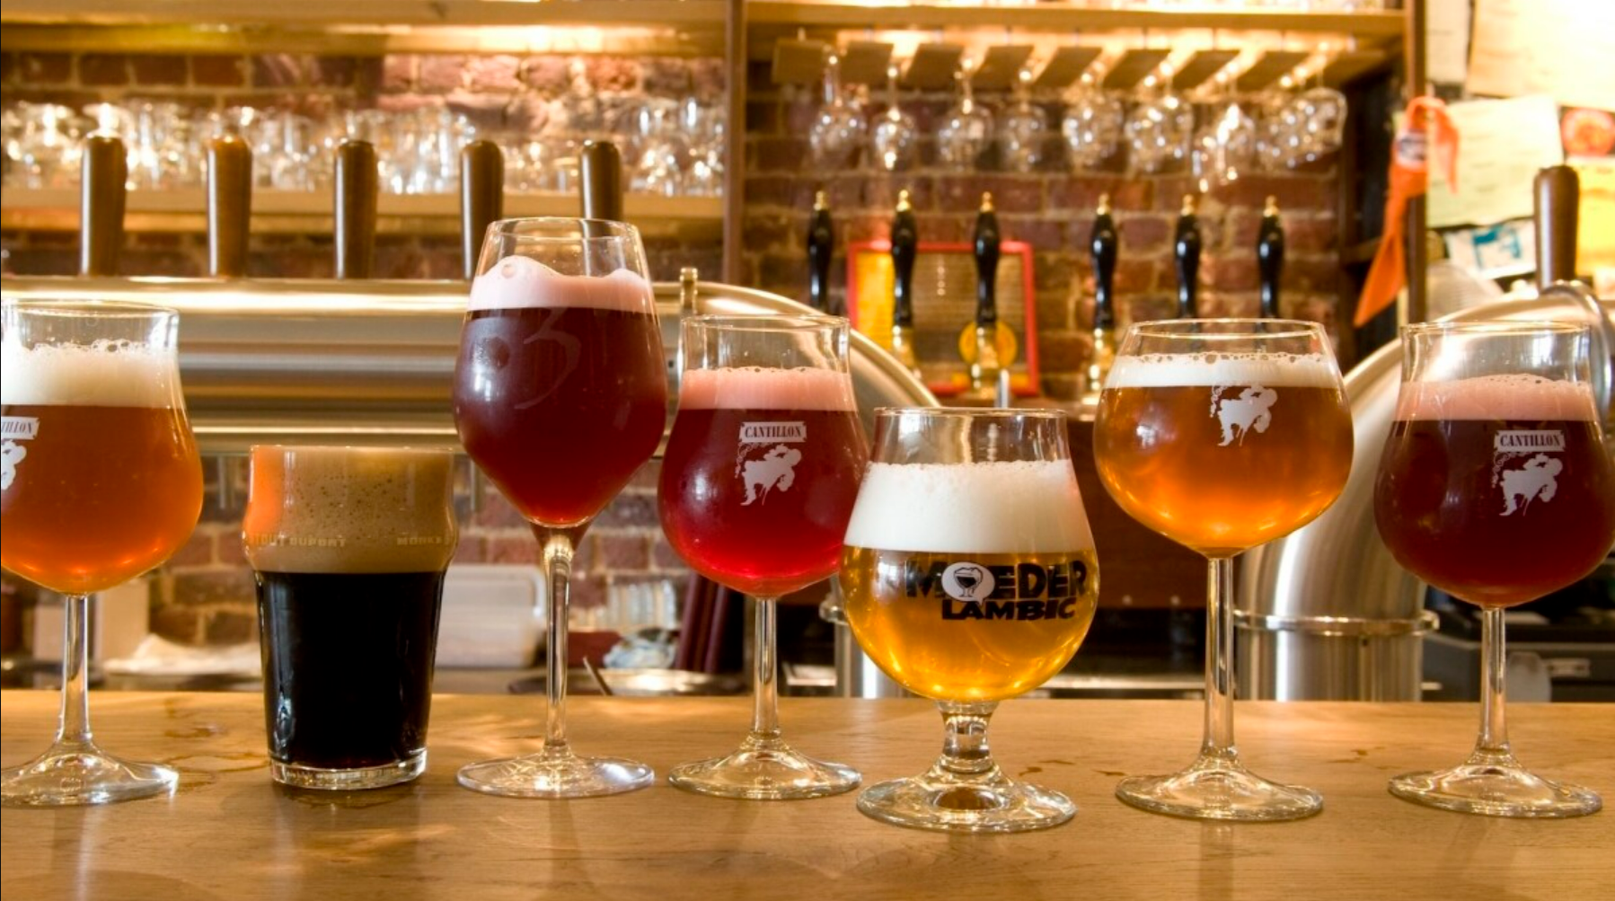
Project 4: Data visualisation
By Romain & Yuchen

Slide 2
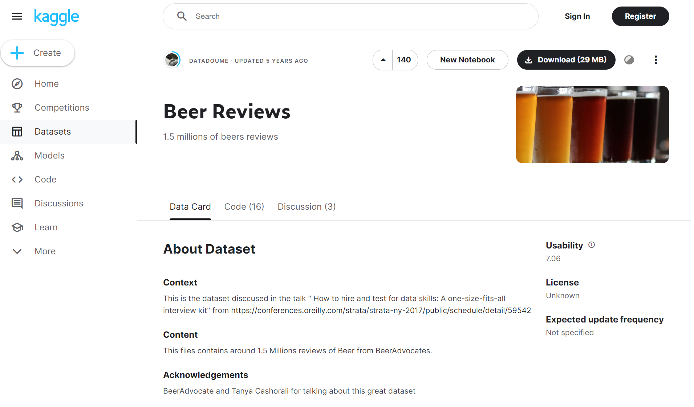
Kaggle Dataset : 1 586 614 Beer reviews
From 2001 to 2012

Slide 3
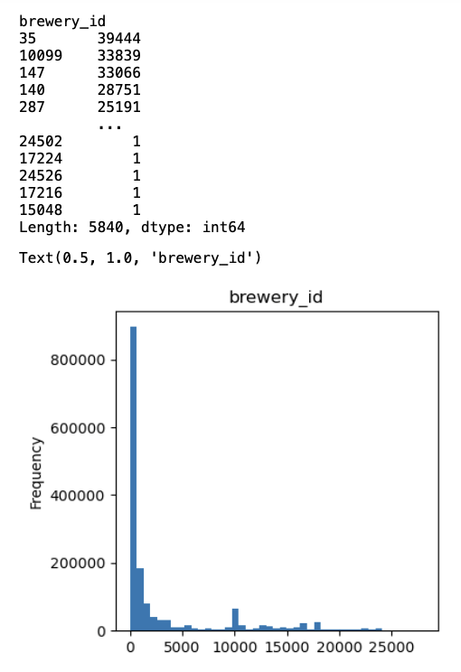
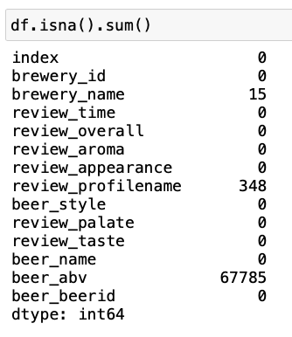
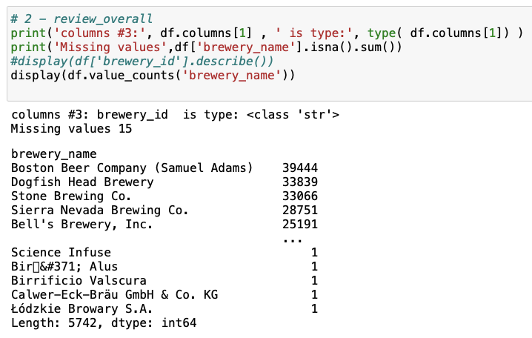
The Original Dataset: Missing Values; Distribution of Beers and Beer Companies

Slide 4
Process of the Workflow
Step 1 (9h-10h, Friday)
Preparation; difficulty in coordinating the Github repo
Step 2 (9h-13h, Friday)
Working together smoothly on Data cleaning and analysis
Step 3 (14h-18h, Friday)
Up and downs in our separate visualization work
Step 4 (Weekend)
Making our dashboards meaningful and preparing for the presentation

Slide 5
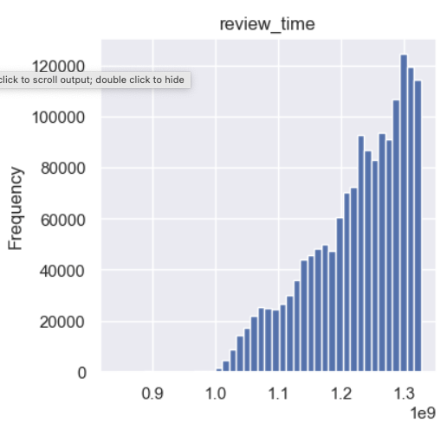
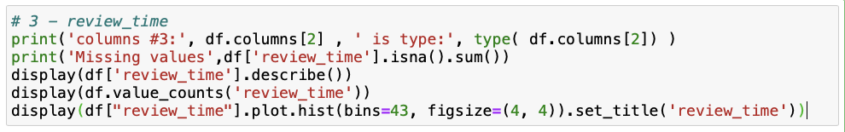
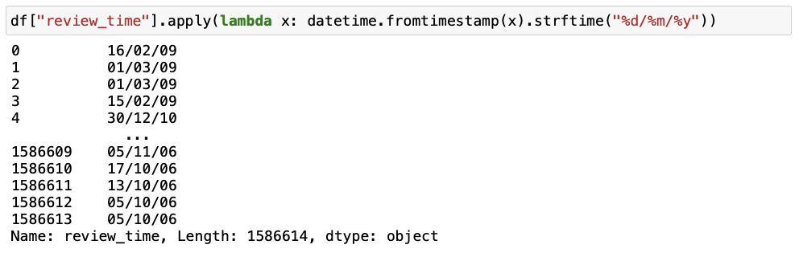
Challenges (I): Converting the Column "review_time"

Slide 6
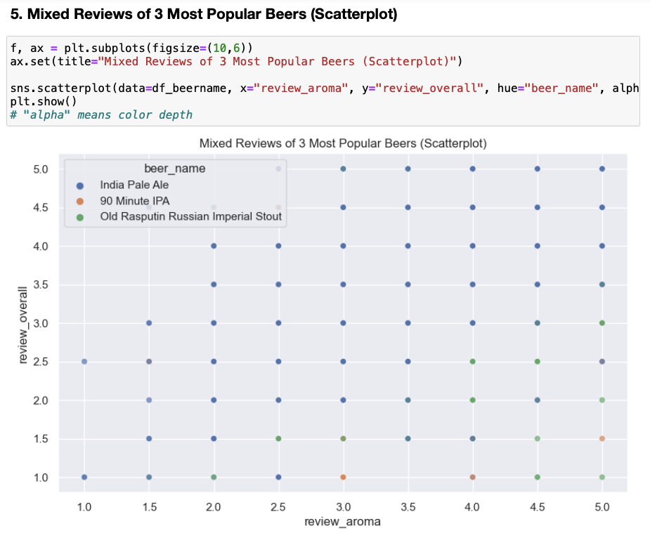
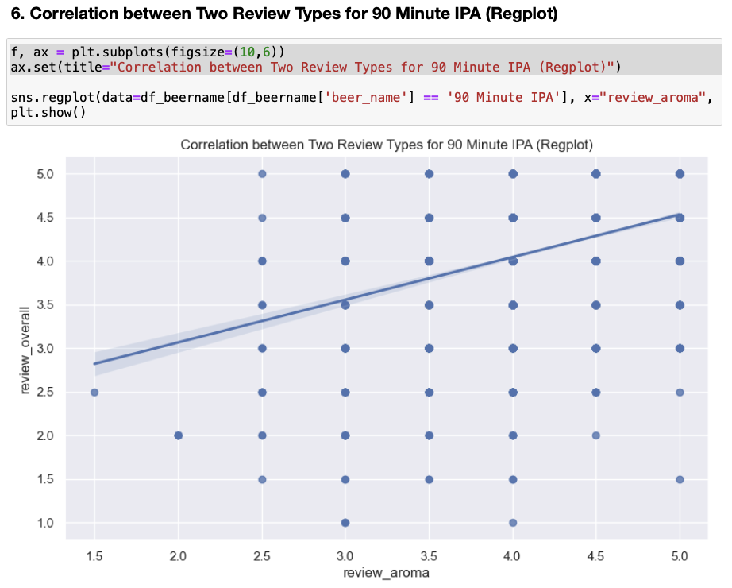

Challenges (II): Producing Meaningful Dashboards
.scatterplot

Slide 7
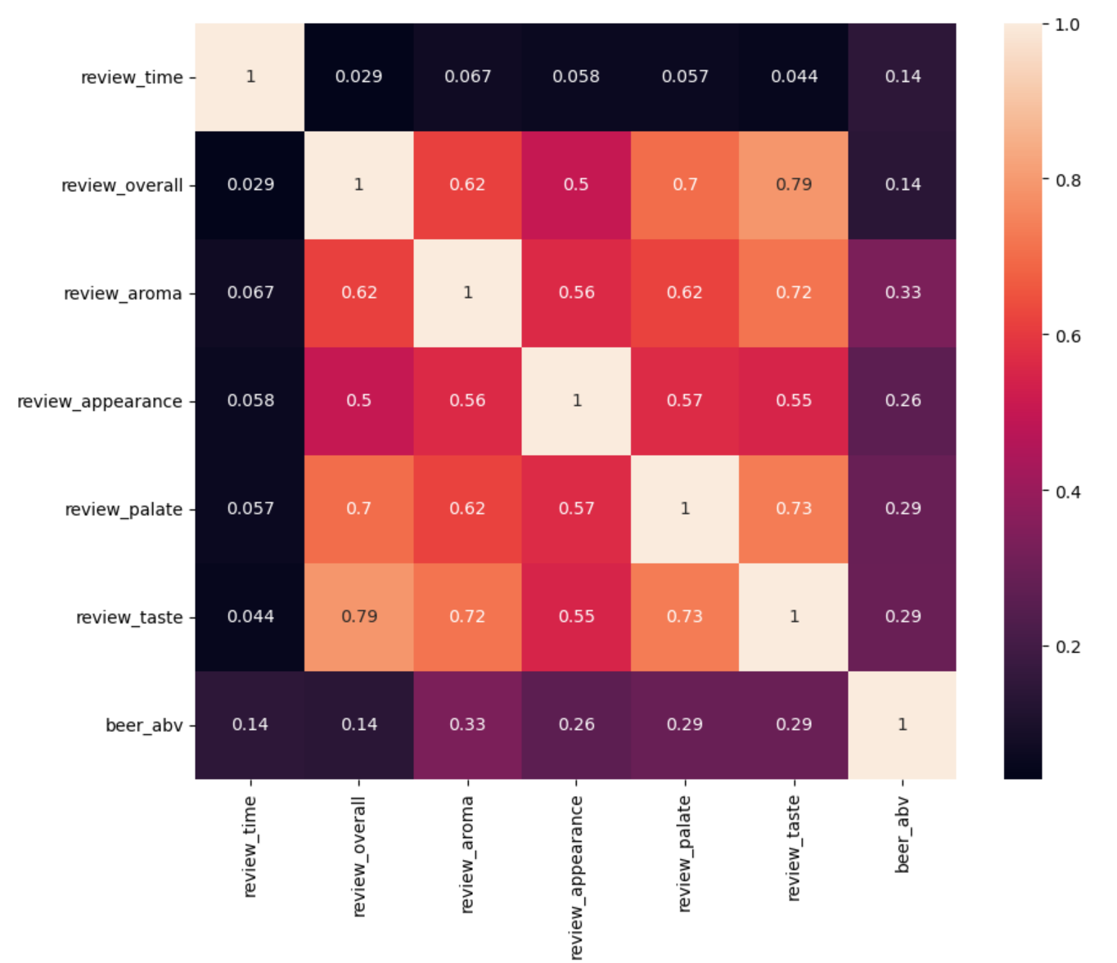
Correlation Map: where comes the most powerful insights
The heatmap reveals that it exists a strong positive correlation between the overall review and the four specific review criteria. Comparatively, the taste has the most significant contribution to the overall satisfaction (0.79) whereas the appearance of the beer is the least important (0.5).
By contrast, the influences of the alcohol percentage (0.14) and the reviewing time (0.029) on the overall review are insignificant.
.heatmap

Slide 8
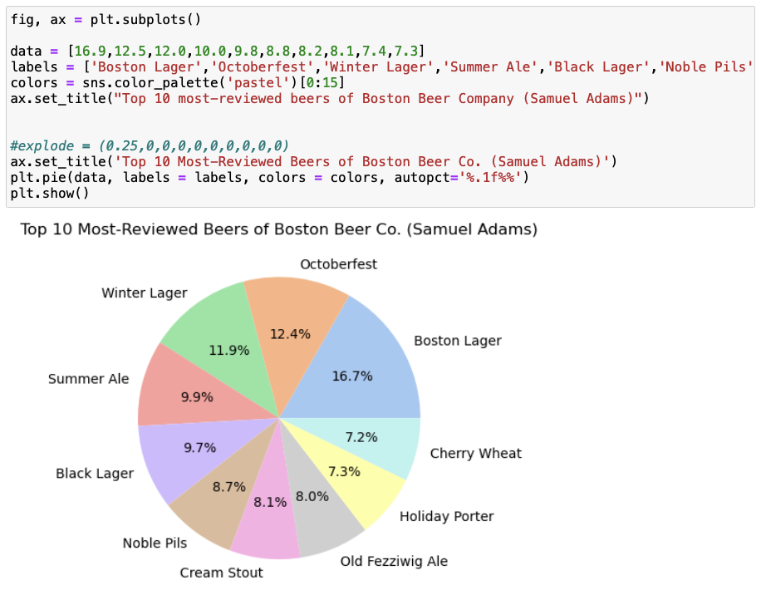
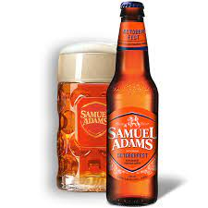
Top 10 Best-seller beers of Boston Beer Company
.pieplot

Slide 9
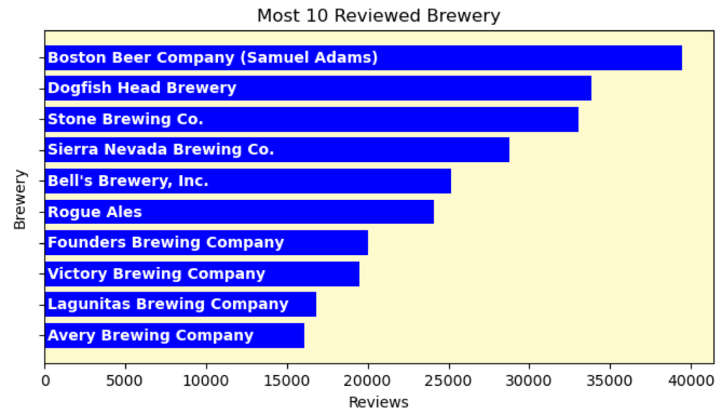
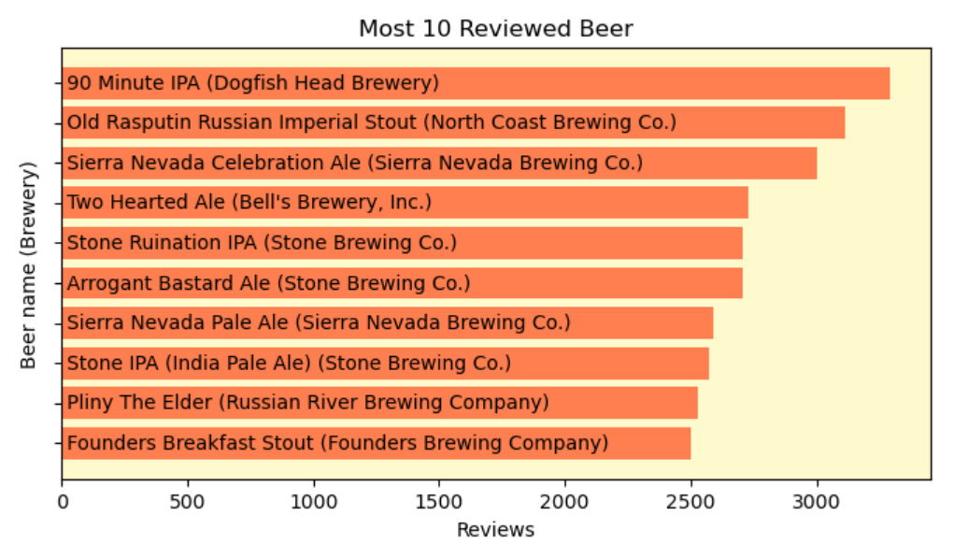
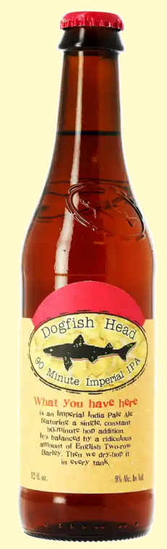


Most Reviewed Beer Companies and Beers
.barh

Slide 10
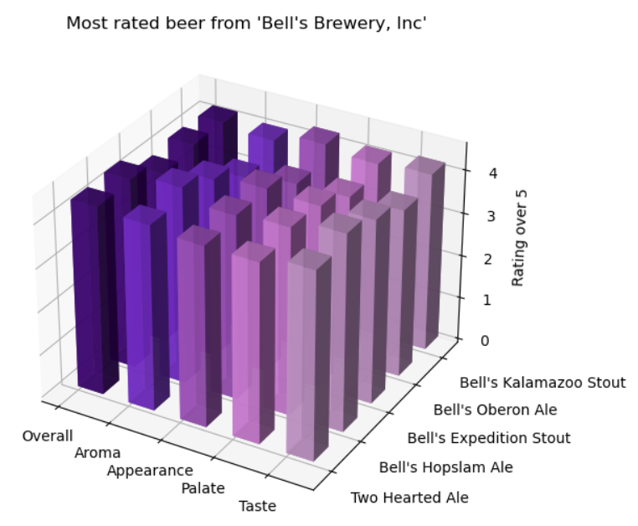
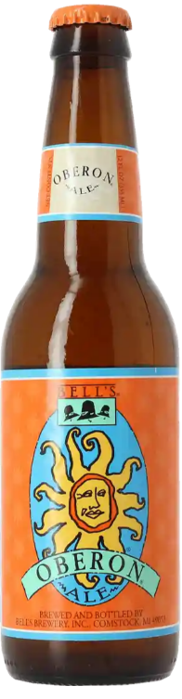
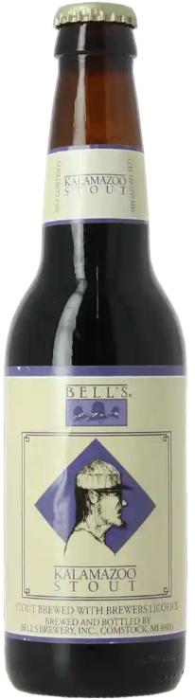
.bar3d

Slide 11
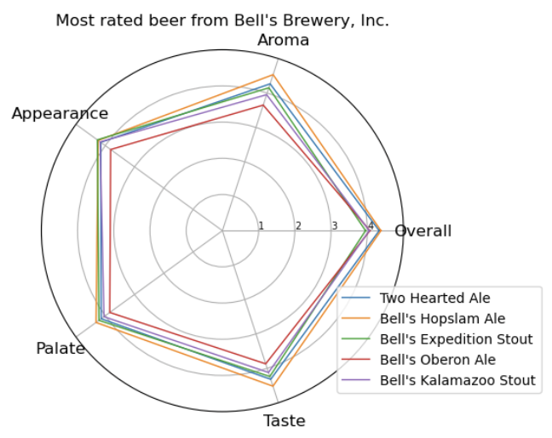
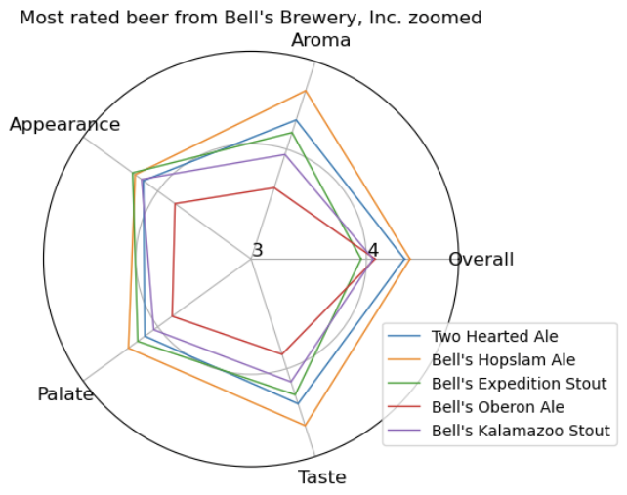
Most Rated for One Brewery (*Confirming the correlations analyzed in the previous slide)
.plot

Slide 12
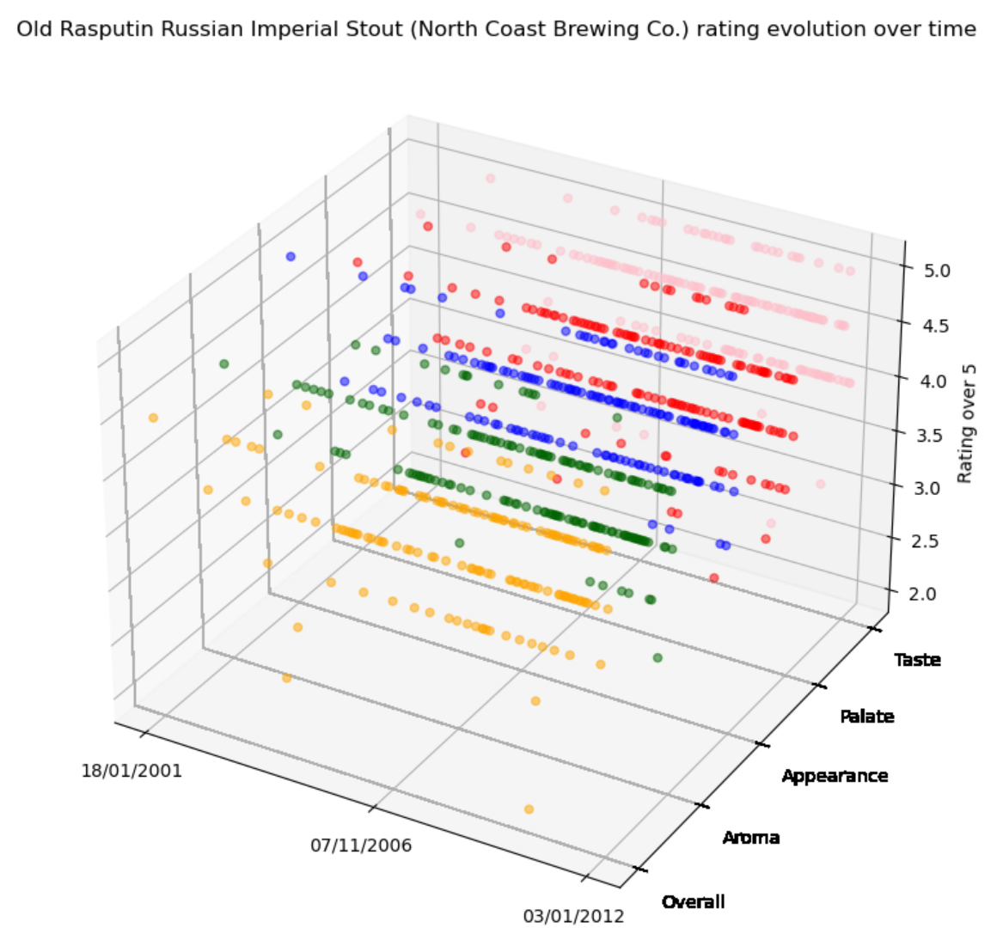
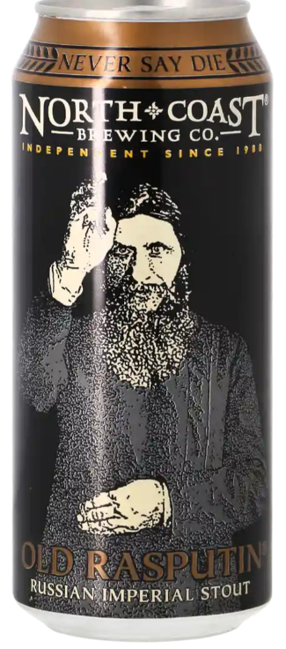
Reviews Over Time
.scatter

Slide 13
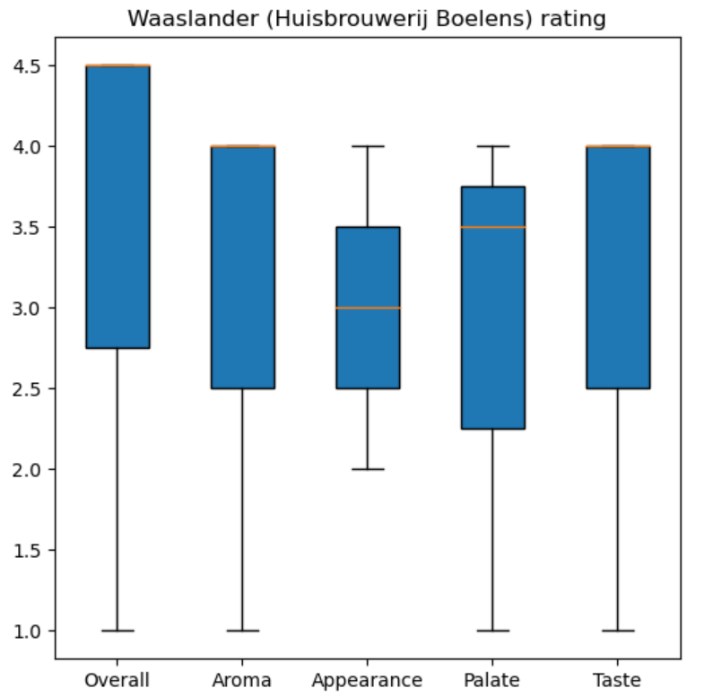
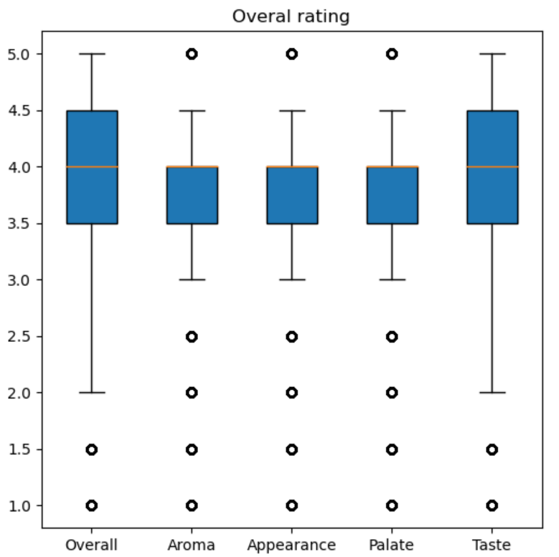
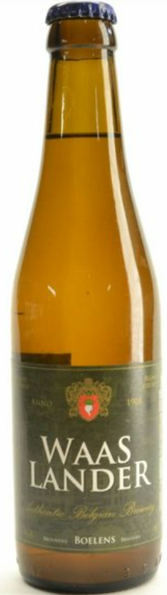
The Beer with the Most Varying Result of the Five Review Criteria
.boxplot

Slide 14

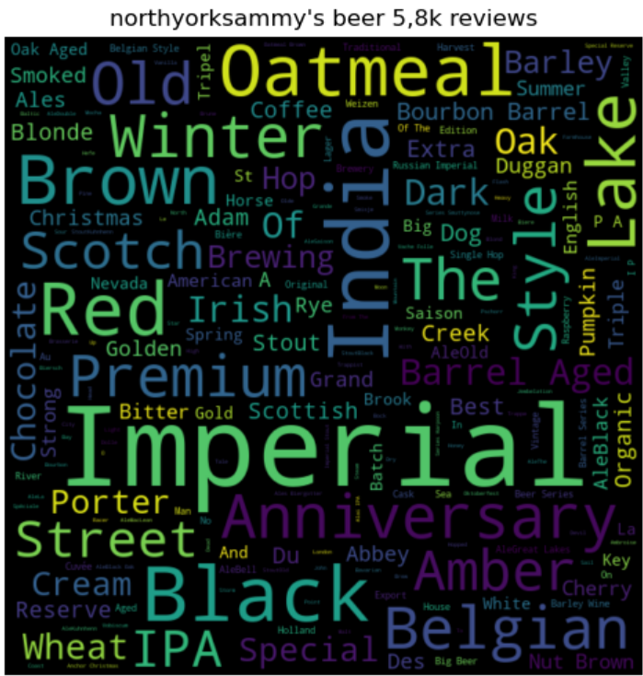
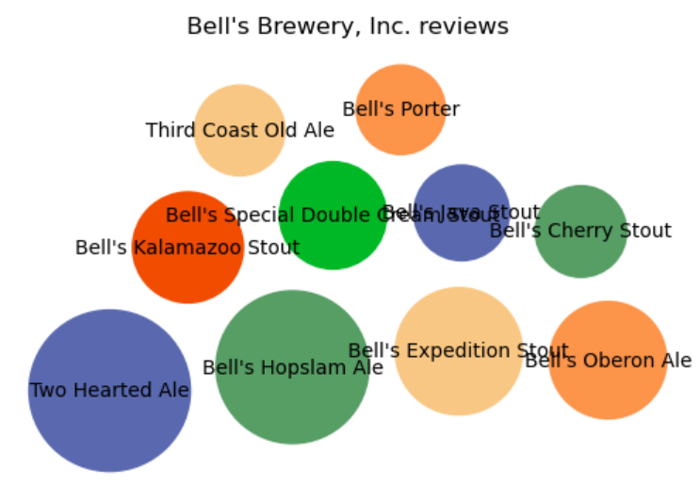
Bubble Chart for Total Reviews Word Cloud on Beer names
import WordCloud
BubbleChart

Slide 15
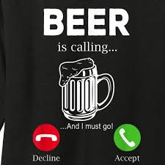
Thanks for Listening! (choose this or the next)

